Slide 1
Scripting Languages
Module 2 Introduction to Shell Script (bash)

Slide 2
Learning Objectives
By the end of this Module you will :
Know the basics of shell script
Be aware of the many commands and utilities you can use in your scripts
Use the bash shell to perform simple tasks on your computer
Write and execute simple bash scripts

Slide 3


What is shell script?

Slide 4
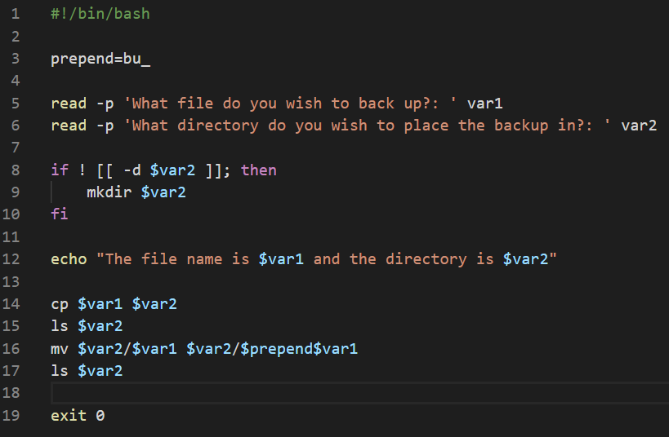
What is Shell Scripting?
A shell script is a series of commands aggregated within a single structured file
A command shell executes this file line-by-line, one command at a time as if individually executed on the command line
A shell script may use control structures, variables and dynamic inputs to control how and when commands are executed
In this sense, shell scripting is a form of computer programming
A simple shell script that allows the user to backup a given file to a given directory

Slide 5
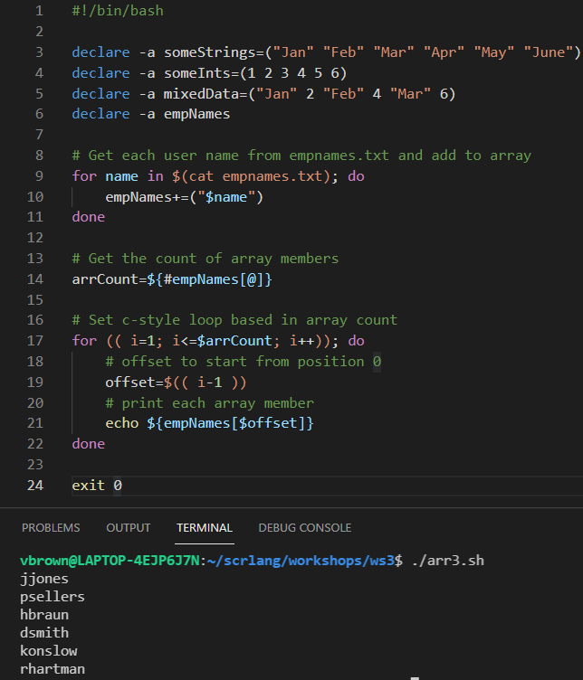
What is Shell Scripting?
Shell scripts allow users to automate repetitive, multi-step tasks and often complex tasks on a Linux installation
Shell script is also used to create custom tools designed to perform highly specific tasks for which no pre-made solution is available
Scripts are usually designed to be executed in a command-line interface, although they can be triggered in other ways, e.g. a scheduled chron job

Slide 6
Working with the bash shell

Slide 7
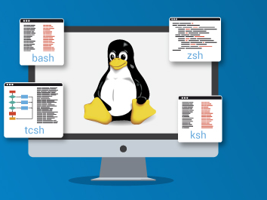
Bash Scripting in the Bash Shell
In this unit, you will write shell scripts for bash, which is short for the Bourne again shell
The bash shell is base on earlier shell version used in Unix-like systems called the Bourne shell, or sh for short
Think of the bash shell as the glue that binds a vast collection of Linux commands together

Slide 8
Bash Scripting in the Bash Shell
bash is compatible with sh commands and scripts
It provides a more modern interface and advanced features
Each keyword used in bash scripting is actually a program
Even control structures such as while or if are actually executable programs being run by the bash shell

Slide 9
bash CLI vs Linux GUI
Any task that can be accomplished by a Linux GUI such as creating folders and editing files…
…can also be accomplished using the bash CLI by executing a bash script in the bash shell.

Slide 10
Shell Script Commands

Slide 11
Common bash Commands
NAME | CLASS | OPERATION
awk | utility | Non-compiled scripting language utility used for simple to complex data manipulation data and report generation
basename | command | Strips directory and suffix from filenames
bc | utility | Arbitrary precision calculator language
cat | command | Concatenate and print (display) the content of files
chmod | command | Change access permissions to files and folders
clear | command | Clear terminal screen of all text
cp | command | Copy one or more files/folders to another location
cut | command | Rules-based division of a file’s or variable’s argument resident data
date | command | Extract, display or change the date/time values
declare | keyword | Declare variables or arrays with pre-defined data types an attributes
df | command | Display free disk space on a storage volume
diff | command | Analyses two files and outputs those lines that are differ
du | command | Estimate file space usage of a file or system volume

Slide 12
Common bash Commands
NAME | CLASS | OPERATION
echo | command | Display textual output to the terminal
eval | command | Evaluate and execute multiple commands/arguments in-situ
exit | command | Exit the shell
expand | command | Convert tabs to spaces in a file
expr | command | Evaluate stated expressions and returns a result
false | keyword | Indicate false result to test, or to do nothing
file | command | Determine file type of argument supplied
find | command | Search for files that meet a desired criteria
for | keyword | Indicates to execute commands on items in file or array one-by-one
grep | utility | Search file(s) for lines that match a given pattern
if | keyword | Conditionally perform a command

Slide 13
Common bash Commands
NAME | CLASS | OPERATION
let | keyword | Perform arithmetic on shell variables
local | keyword | Create a function variable
ls | command | List information about file/folders
man | command | Help manual
mkdir | command | Create/make a new directory (folder)
mv | command | Move or rename files or directories
printf | command | Format and print data to output, e.g. terminal, file, variable
pwd | command | Prints path to Working Directory to terminal or other output
read | keyword | Read a line from standard input
return | keyword | Exit a shell function, usually with a return value
rev | command | Reverse lines of a file
rm | command | Remove files/folders
rmdir | command | Remove folder(s) (only if empty)

Slide 14
Common bash Commands
NAME | CLASS | OPERATION
sed | utility | Stream Editor, a.ka. search and replace
seq | command | generate numbers from FIRST to LAST in steps of INCREMENT
shuf | command | Generate random permutations of provided arguments
sort | command | Sort text files according to stipulated criteria
tee | command | Redirect output to multiple outputs, e.g., terminal and file
test | keyword | Evaluate a conditional expression
touch | command | Create a new file or update an existing file's timestamp
tr | command | Translate, squeeze, and/or delete characters
true | keyword | Indicate true result to test, or trigger to do something
uniq | command | Filters out duplicate items in a file
unset | keyword | Remove variable or function names
until | keyword | Indicates command execution until a criteria is no longer true
wc | command | Count the bytes, words, or lines in a file or variables contents
which | command | Search the user's $path for a program file
while | keyword | Indicates command execution until a criteria is no longer false

Slide 15
Shell Script Editors

Slide 16
Text Editors
Text editors are used to create and edit scripts
Different programmers vary in which text editor they prefer
Some are text based and others graphically based
Text-based script editors include VI or ViM, nano and emacs and are used in server environments where no GUI is available
Graphical-based script editors include VS Code, gedit, Atom and sublime and are often used in desktop development environments where a GUI is available
In this unit, the VS Code development environment will be provided within a Ubuntu virtual machine

Slide 17
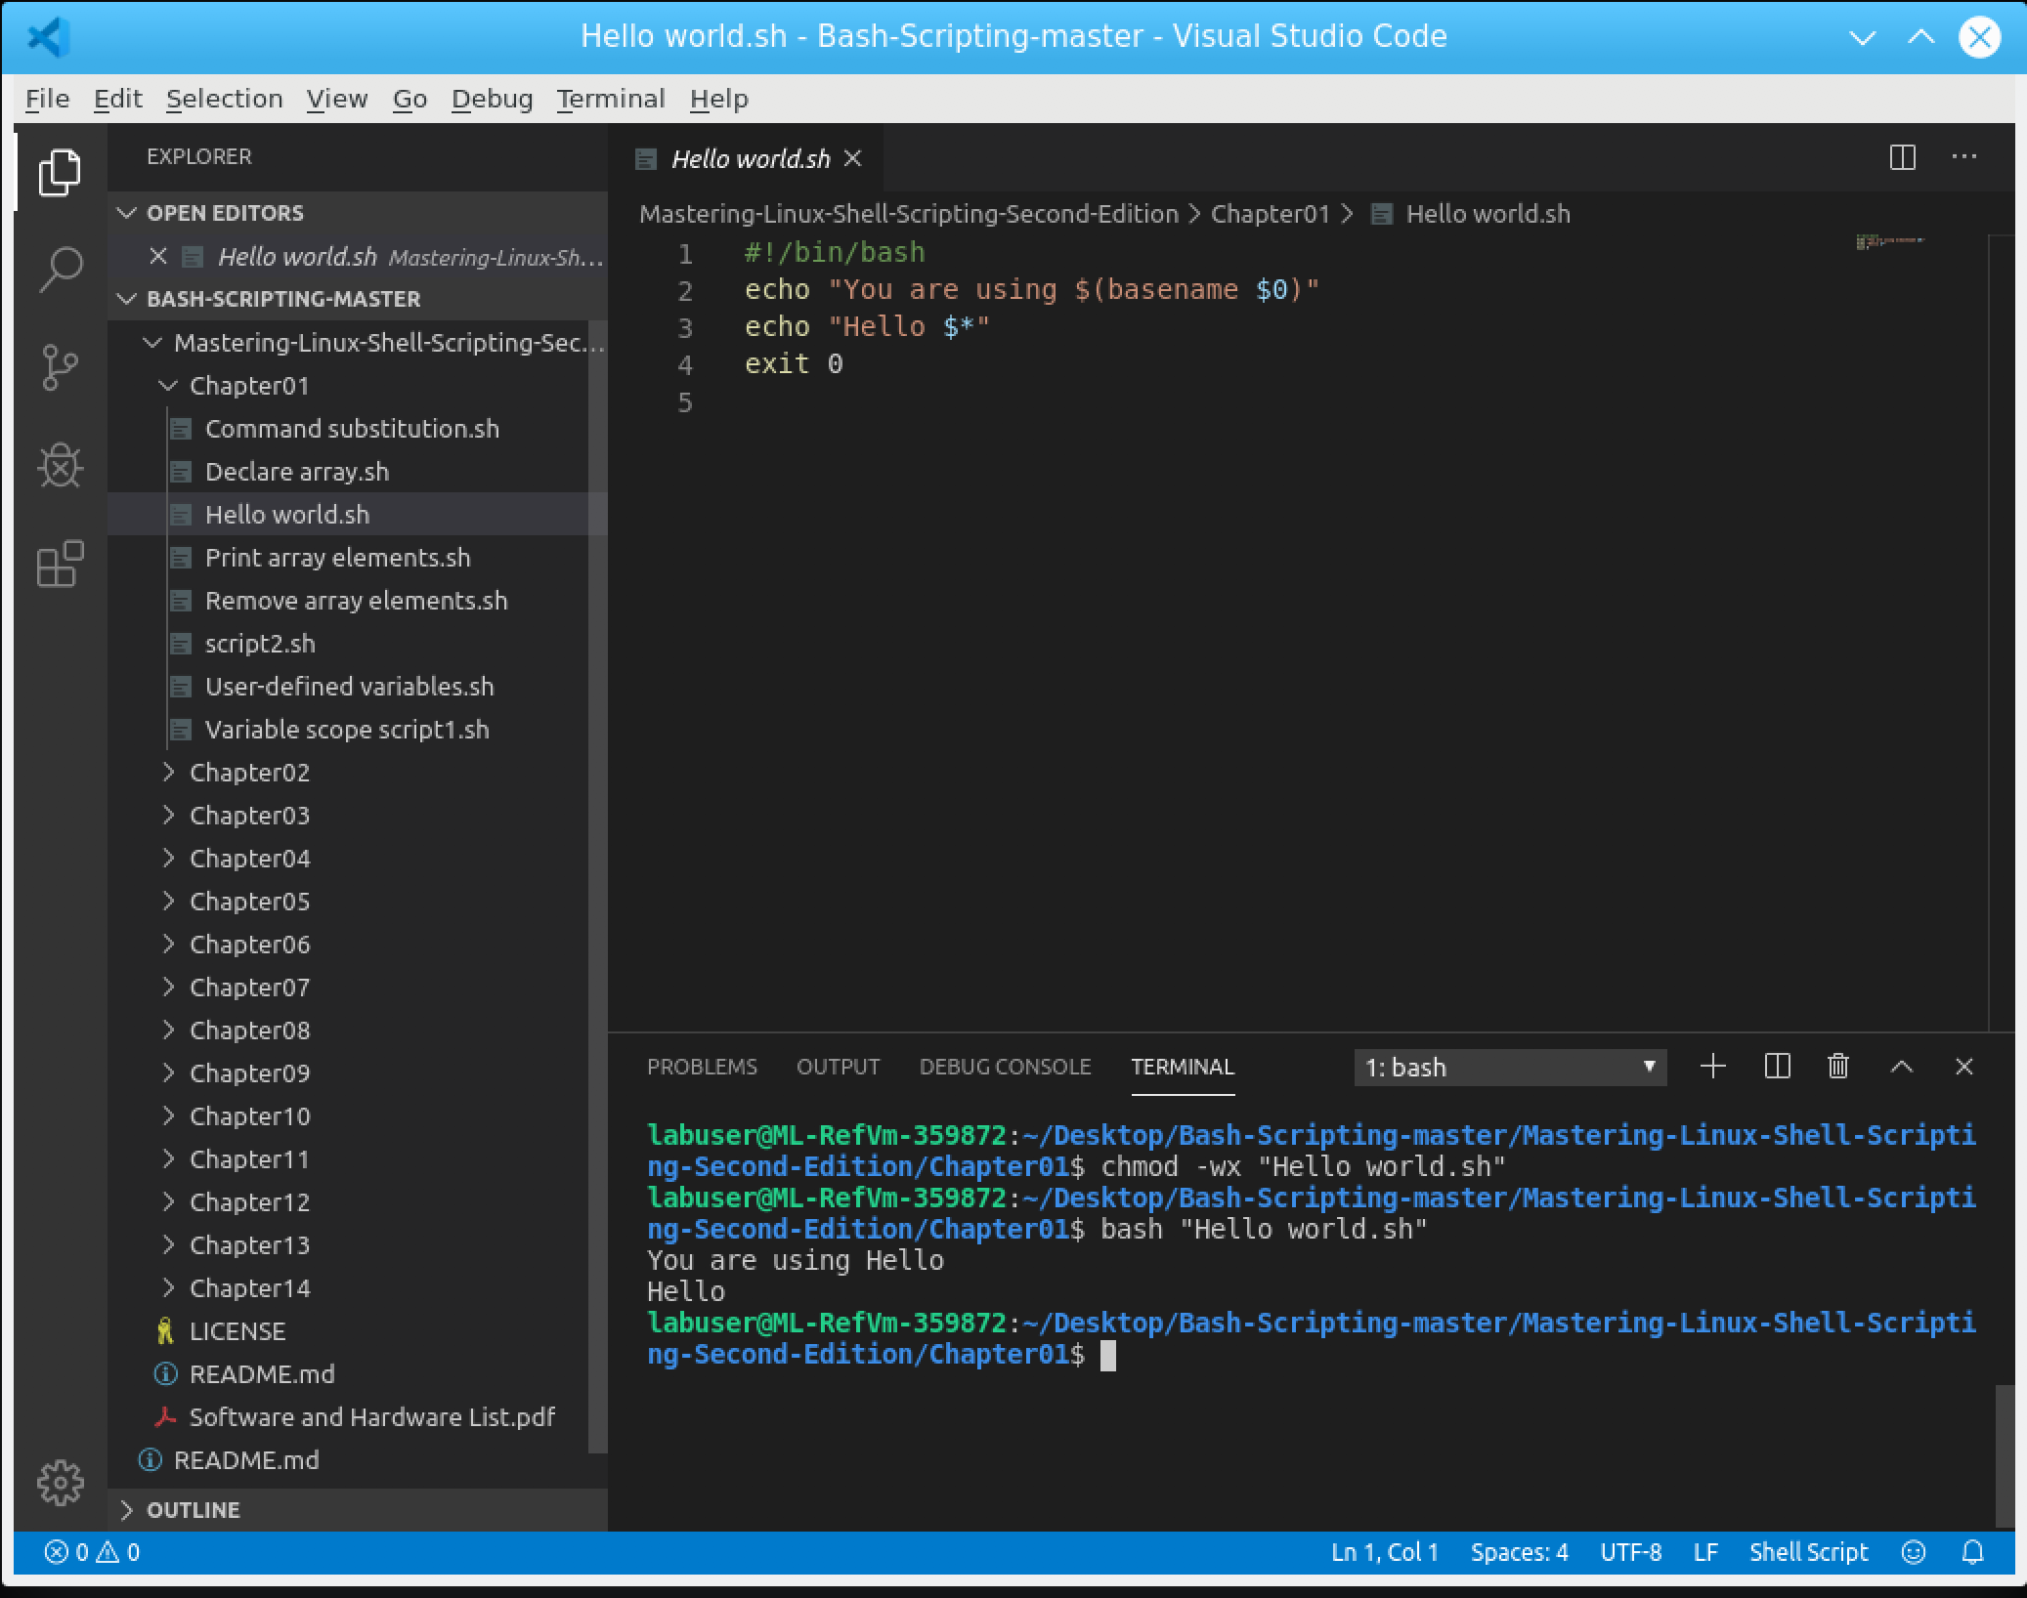
VS Code
Visual Studio Code is a cross platform text editor made by Microsoft
It is not to be confused with the Visual Studio IDE
VS Code is designed to be a light-weight, cross platform editor for development
Additional features can be added through custom extensions

Slide 18
Writing a bash shell script

Slide 19
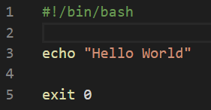
The Hello World Script
Most programming beginners start out by writing a simple program to output the words Hello World on the screen
In bash scripting, this can be accomplished with the script shown to right

Slide 20
The Hello World Script
#!/bin/bash
echo "Hello World!"
exit 0
The #!/bin/bash comment tells Linux to use bash when interpreting the script as opposed to another interpreter such as required by php, perl or python
The echo command is a built-in shell command used to write its argument to a standard output
The standard output, a.k.a. stdout prints the argument to the terminal screen by default
The information to be printed is enclosed in double quotes “Hello World” which tells the system specifically what is to be sent to stdout
exit 0 is an error status code that means the script has executed successfully without error

Slide 21
Executing the script
In most operating systems, files are not allowed to be directly executed as scripts by default
Most scripts will need to have the correct permissions set to allow them to be executed
A script without the execute permissions can be manually executed by invoking the bash command but this is not ideal
$ bash hello1.sh

Slide 22
Executing the script
Permissions can be set using the chmod command
$ chmod +x hello1.sh or
$ chmod 777 hello1.sh
This only needs to be done once.
After the file is marked as executable, the script can be run by prepending it with ./ and hitting Enter
$ ./hello1.sh

Slide 23
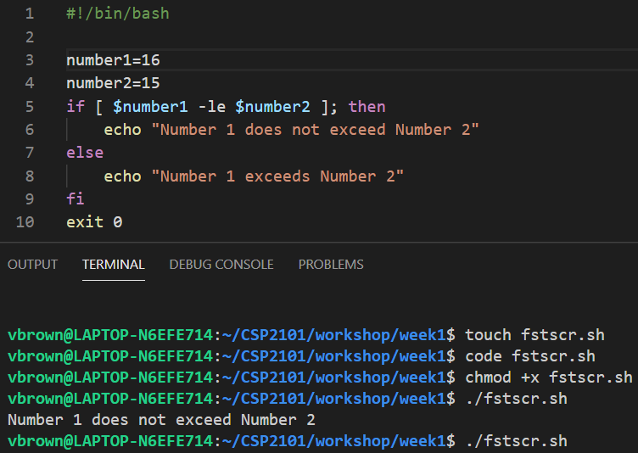
Writing and Executing a bash Script
Using the VS Code development environment
Shell Script
Commands to create shell script file, make it executable and run it
~/CSI6203/
~/CSI6203/
~/CSI6203/
~/CSI6203/
~/CSI6203/

Slide 24
Working with variables and arguments

Slide 25
Variables
Information in bash scripts can be stored in variables
Once information is stored in a variable, it can be called upon in the script by invoking the variable’s name
IMPORTANT NOTE:
When you declare a variable and/or assign it an argument, you do so without the $ prepend, as shown in the yellow boxes. However, when you call upon a variable to use its argument in the code, you must use the $ prepend in each case as shown in the blue boxes.

Slide 26
Passing Arguments to Default Variables
There are some special variables that are used for receiving input from the command line as they are executed
Each argument typed into the command line is referred to by a special numeric variable
Special Variable | Argument
$0 | Holds the name of the script being run
$1, $2, $3 etc | Arguments passed along with the running of the script on the command line, e.g. myscript.sh 20 30 40 - $1 is the first argument, i.e. 20, $2 the second arguments, i.e 30 and $3 is the third argument, i.e. 40 ..and so on
$# | Holds the number of arguments passed to the script
$? | Holds the last output of the script Note: This can change constantly as the script executes
$ ./hello.sh Tom
Hello Tom
#!/bin/bash
echo "Hello $1!"

Slide 27
Arguments
The following variables are available to handle arguments
These can be used to print custom messages or get the name of the script
Argument Name | Purpose
$0 | The name of the script file
$1 | The first argument sent to the script
$2 | The second argument sent to the script
$# | The number of arguments sent to the script
$* | All the arguments sent to the script

Slide 28
References and Resources
Ebrahim, M., & Mallett, A (2018). Mastering Linux Shell scripting: A practical guide to LInux command-line, Bash scripting, and Shell programming (2nd Ed.). Birmingham UK: Packt.
An A-Z Index of the Linux command line: bash + utilities. Available at SS64.com
Bash Reference Manual. Available at https://www.gnu.org/savannah-checkouts/gnu/bash/manual/bash.html

Slide 29
Terms to Review and Know
Shell scripting
Bash shell and scripting
Text Editors
Variables
Git and github.com

